Slide 1
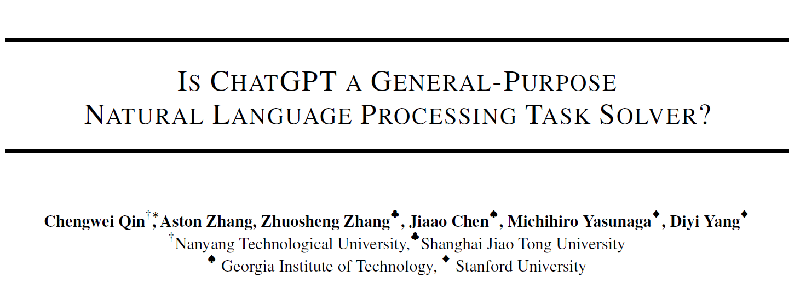

Slide 2
Abstract
Background:
large language models (LLMs) have demonstrated the ability to perform a variety of NLP tasks zero-shot. ChatGPT has drawn a great deal of attention from the NLP community
Motivation:
it is not yet known whether ChatGPT can serve as a generalist model that can perform many NLP tasks zero-shot
Approach:
we empirically analyze the zero-shot learning ability of ChatGPT by evaluating it on 20 popular NLP datasets covering 7 representative task categories

Slide 3
Introduction
LLMs could solve NLP tasks zero shot—i.e., without relying on any training data for a given downstream task—by conditioning the model on appropriate prompts
OpenAI’s ChatGPT has attracted attention from the NLP community, which created by training GPT-3.5 models through reinforcement learning from human feedback(RLHF)
ChatGPT shows strong dialogic capabilities. However, it still remains unclear whether ChatGPT attains better zero-shot generalization compared with existing LLMs

Slide 4
Introduction
we study the zero-shot learning capability of ChatGPT by evaluating it on 7 task categories: reasoning, natural language inference, question answering, dialogue, summarization, named entity recognition, and sentiment analysis
we aim to answer the following research questions:
Is ChatGPT a general-purpose NLP task solver? On what types of tasks does ChatGPT perform well?
If ChatGPT fell behind other models on certain tasks, why?
we compare the performance of ChatGPT and the most advanced GPT-3.5 model (text-davinci-003). Besides, we report zero-shot, fine-tuned, or few-shot fine-tuned results from recent work

Slide 5
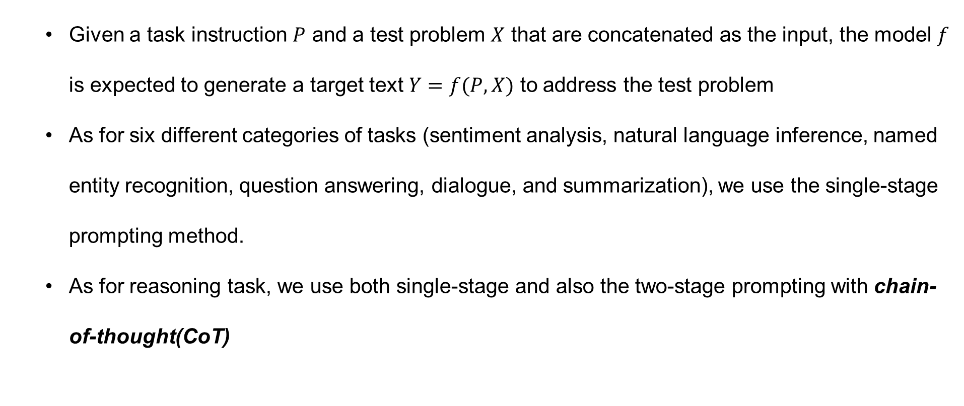
Methodology
Given a task instruction $P$ and a test problem $X$ that are concatenated as the input, the model $f$ is expected to generate a target text $Y=f(P,X)$ to address the test problem
As for six different categories of tasks (sentiment analysis, natural language inference, named entity recognition, question answering, dialogue, and summarization), we use the single-stage prompting method.
As for reasoning task, we use both single-stage and also the two-stage prompting with chain-of-thought(CoT)
Notes:
任务指示P

Slide 6
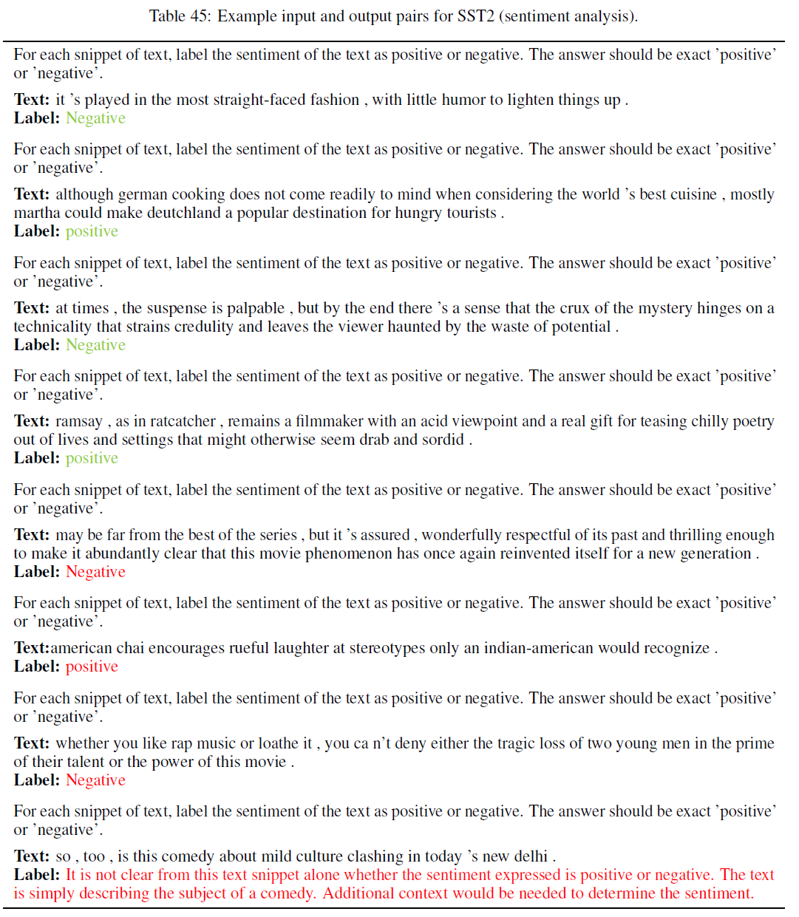
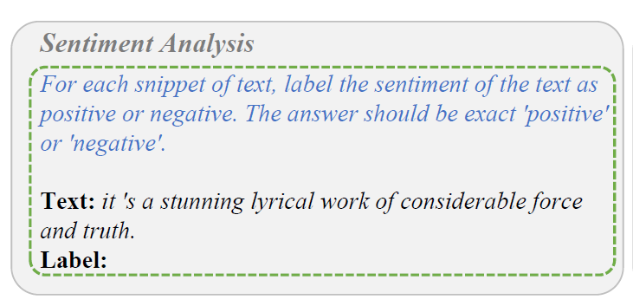
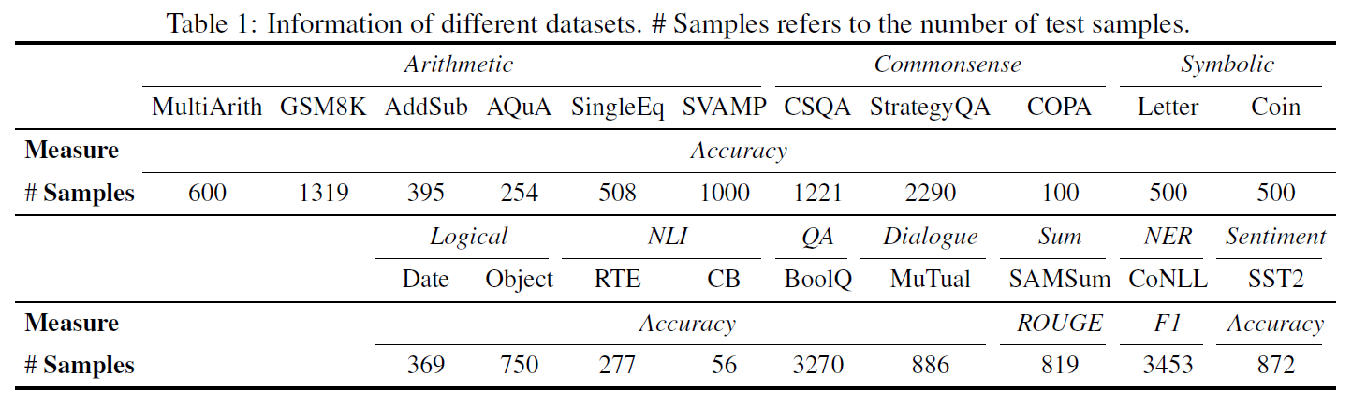
Methodology
Notes:
比较有意思的现象是
Chatgpt可能既不输出negative也不输出positive，那么这样的结果自然是不正确的

Slide 7
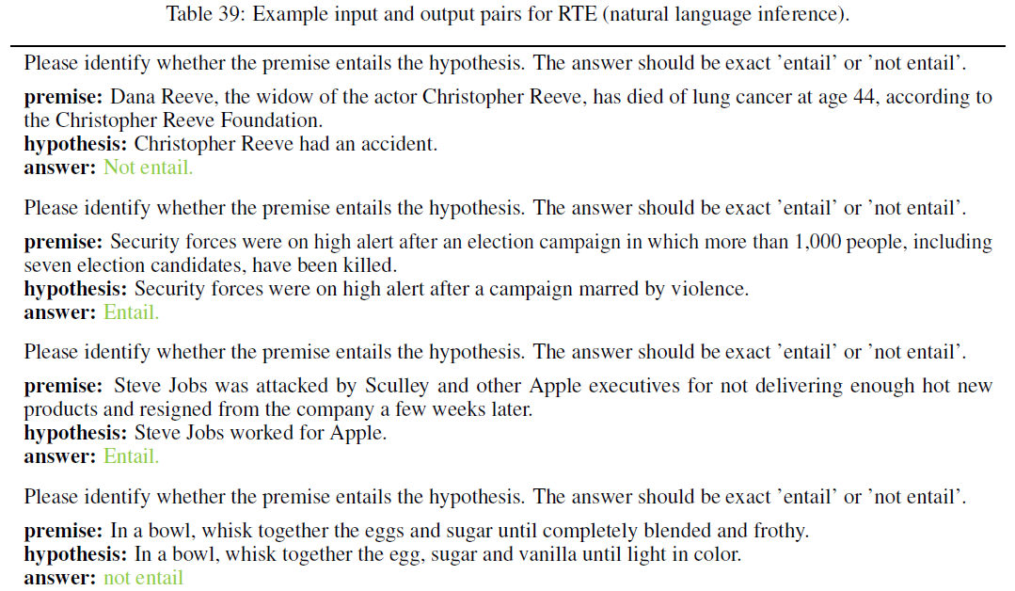
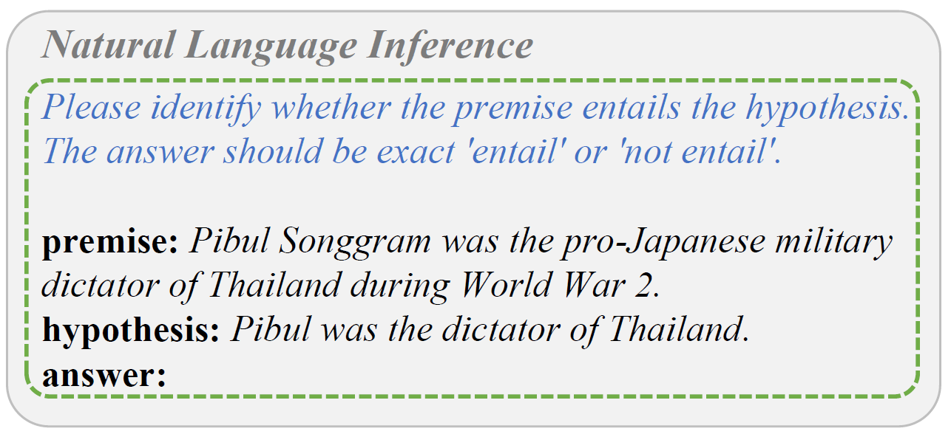
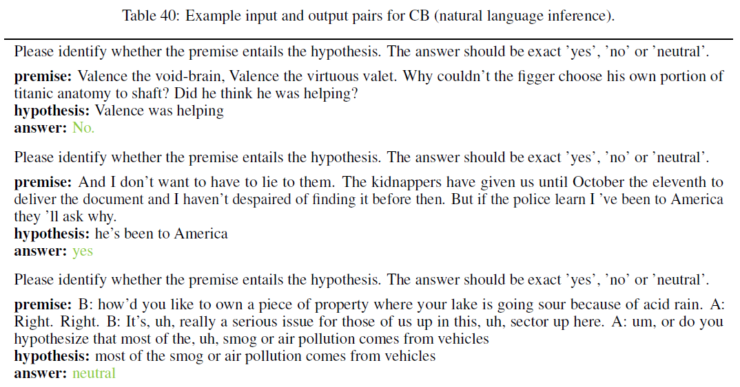
Methodology
Notes:
确定能推断
确定不能推断 （事实冲突）
没关系

Slide 8
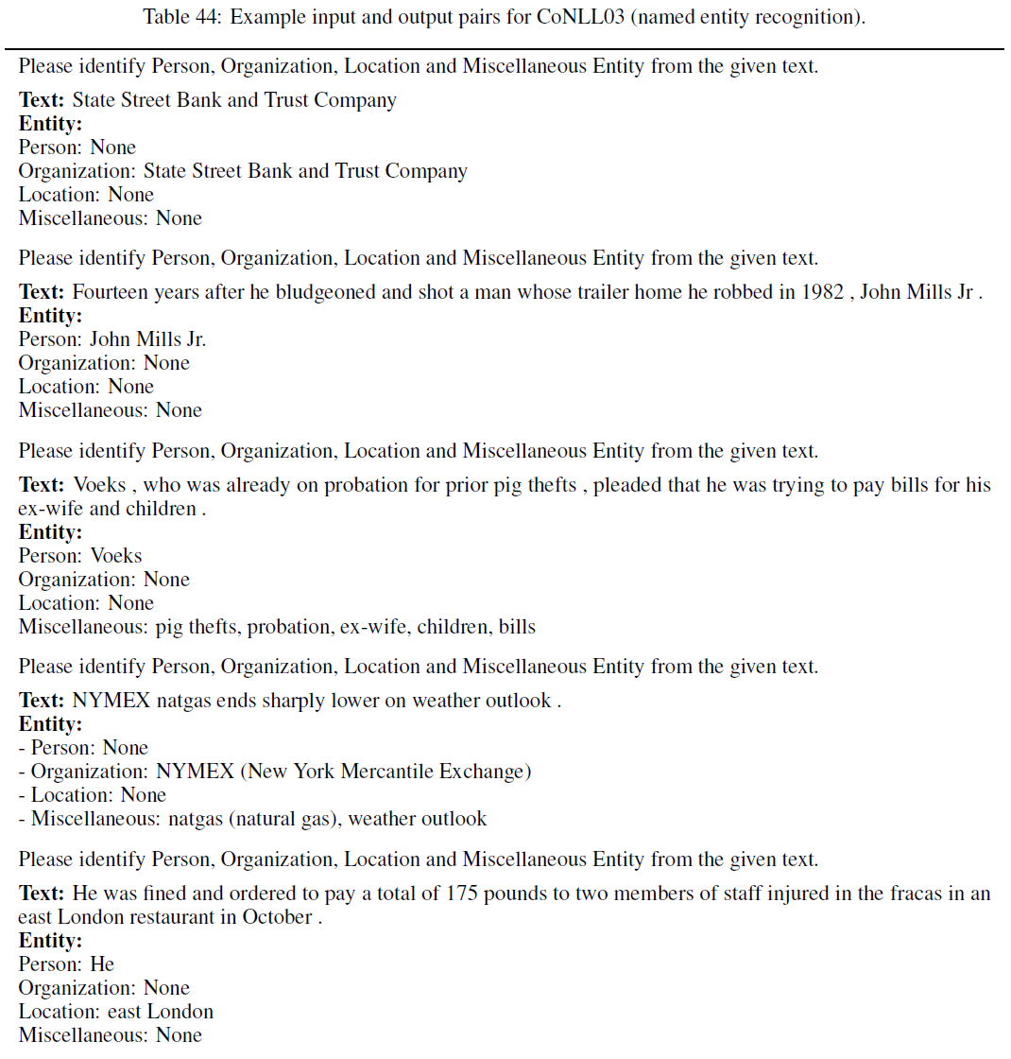
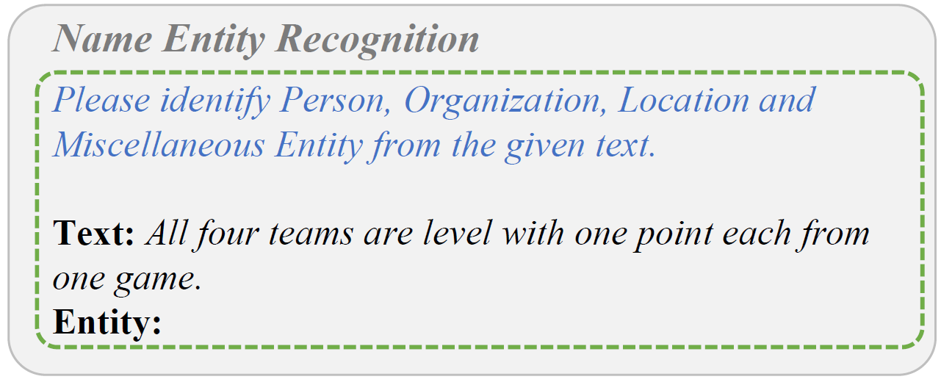
Methodology
Notes:
混杂的实体

Slide 9
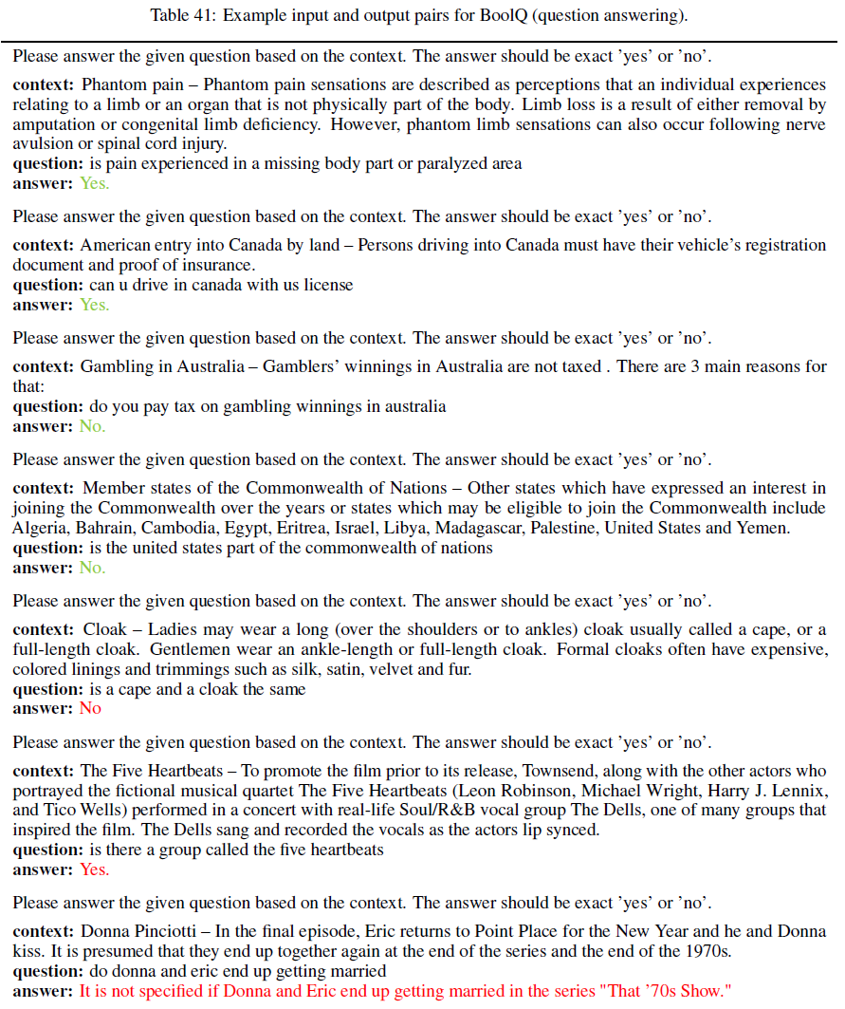
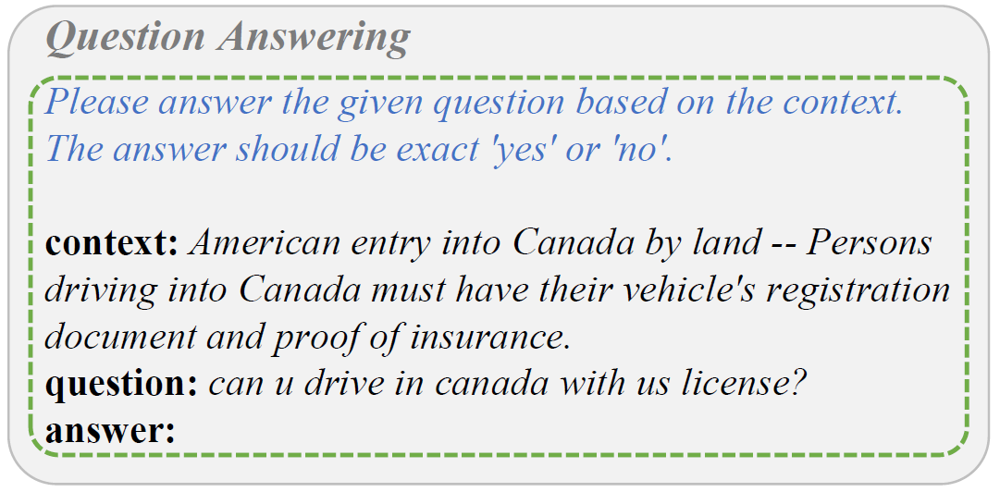
Methodology
Notes:
QA任务里同样可以发现，尽管在指示里做了限制，但是chatgpt还是可能会输出除了yes和no以外的回答

Slide 10
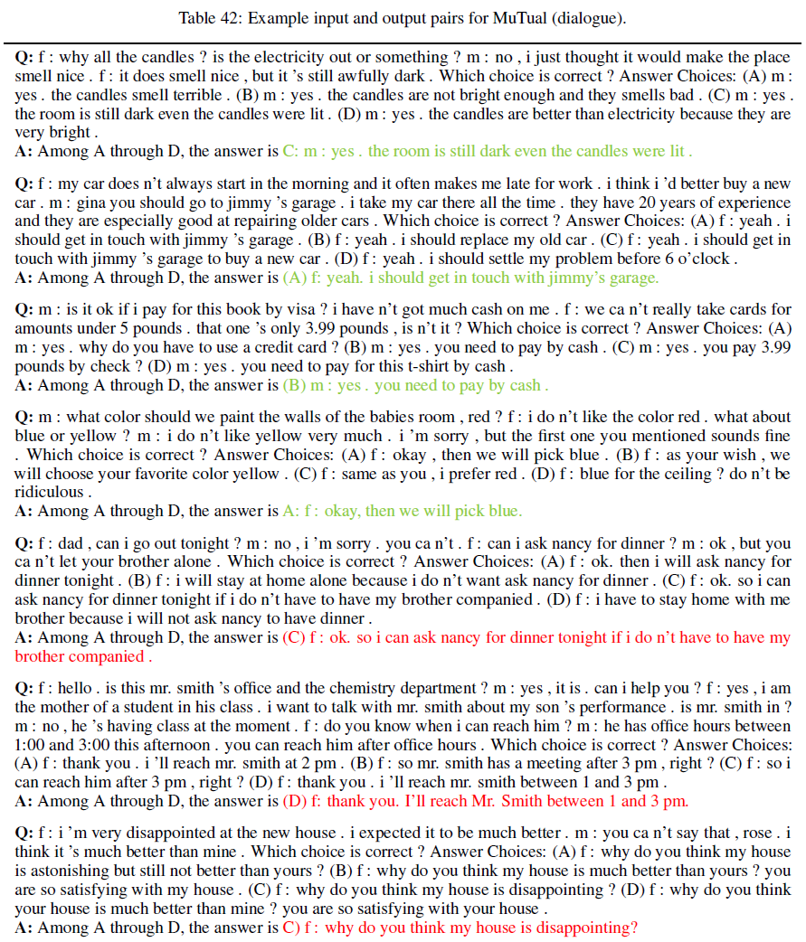
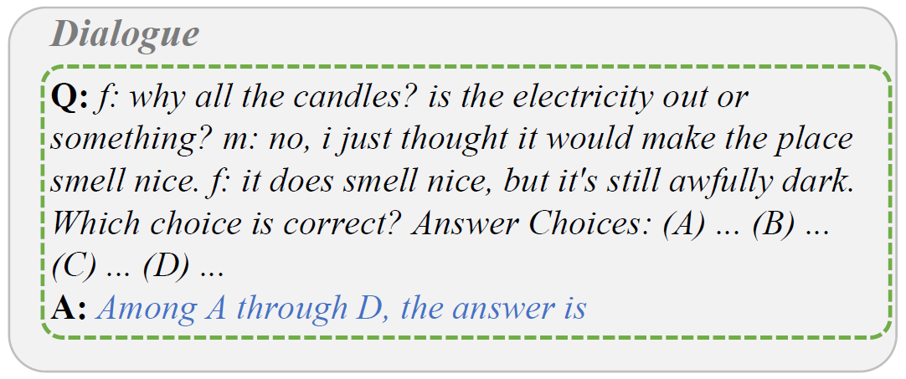
Methodology
Notes:
多轮对话能力
Q里边是两个人进行多次对话，然后抛出一堆答案，然后要求模型从这几个选项中选一个

Slide 11
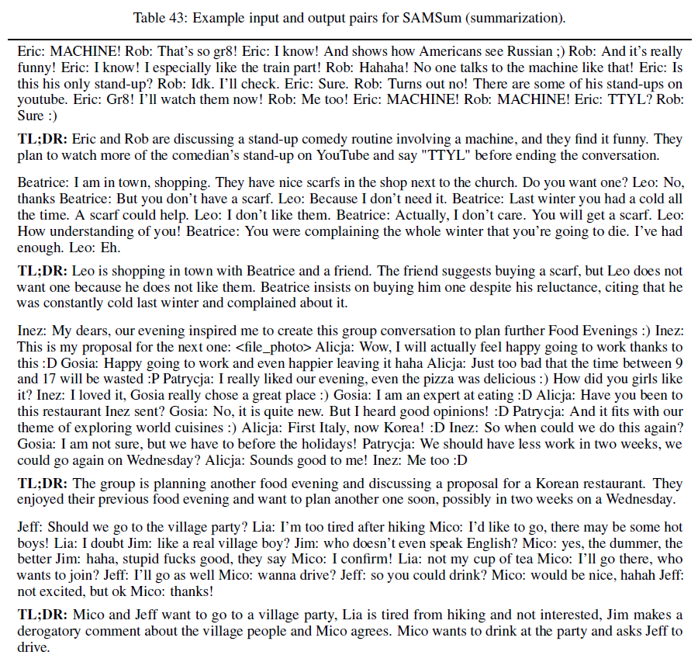
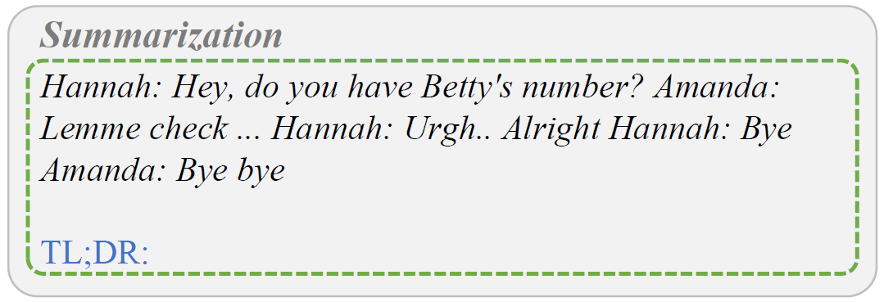
Methodology
Notes:
TLDR, 英语俚语
Too long don’t read
太长不看

Slide 12
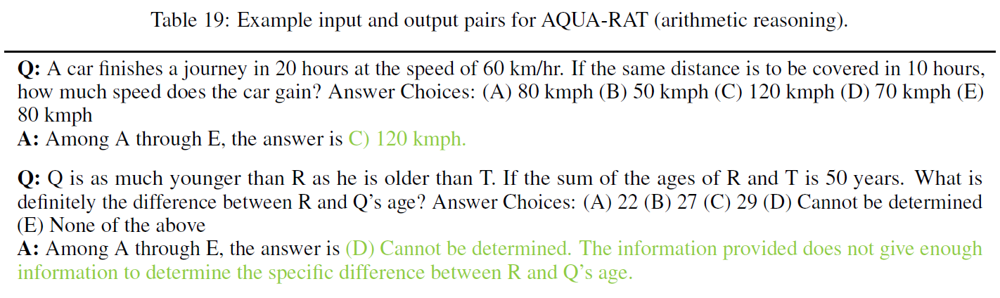
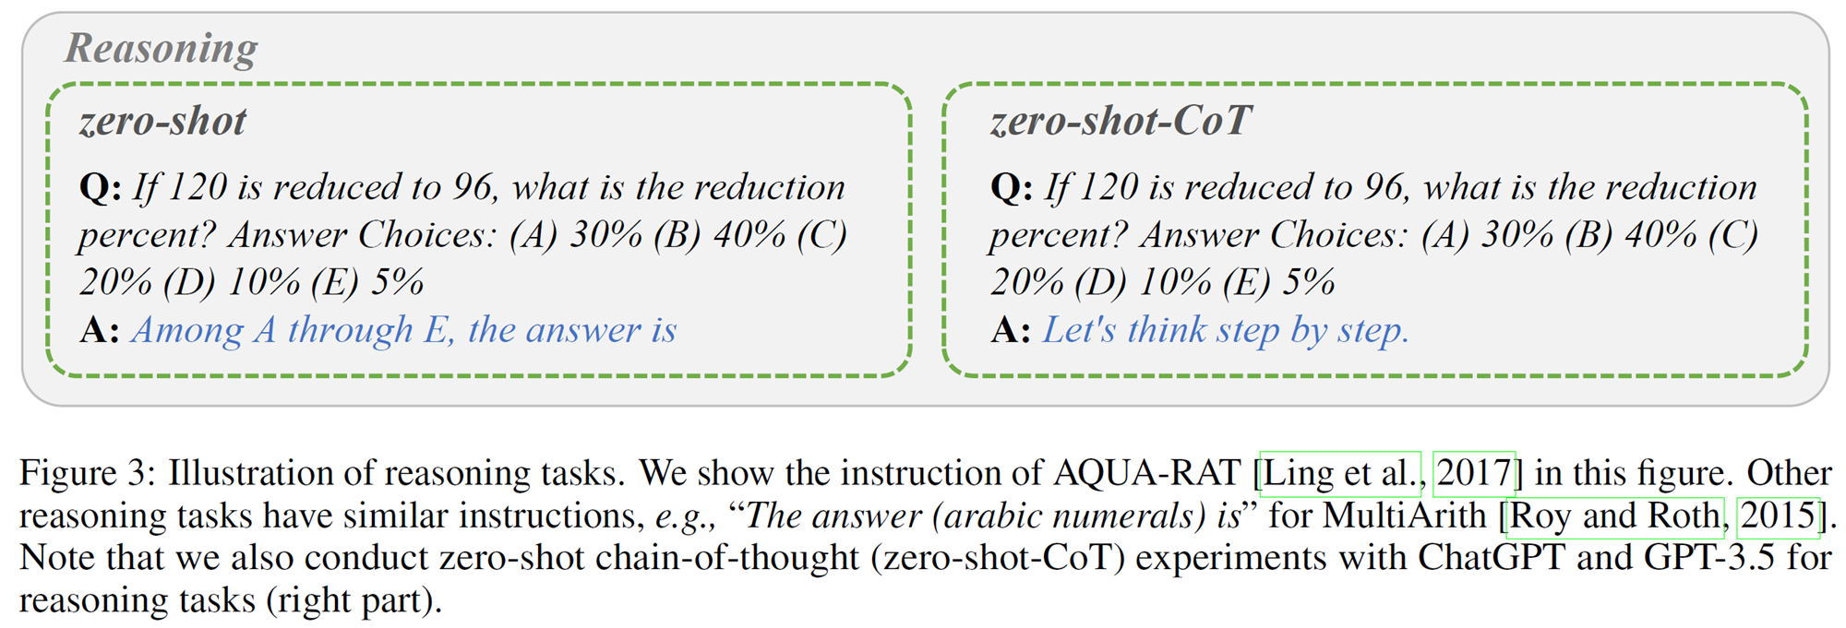
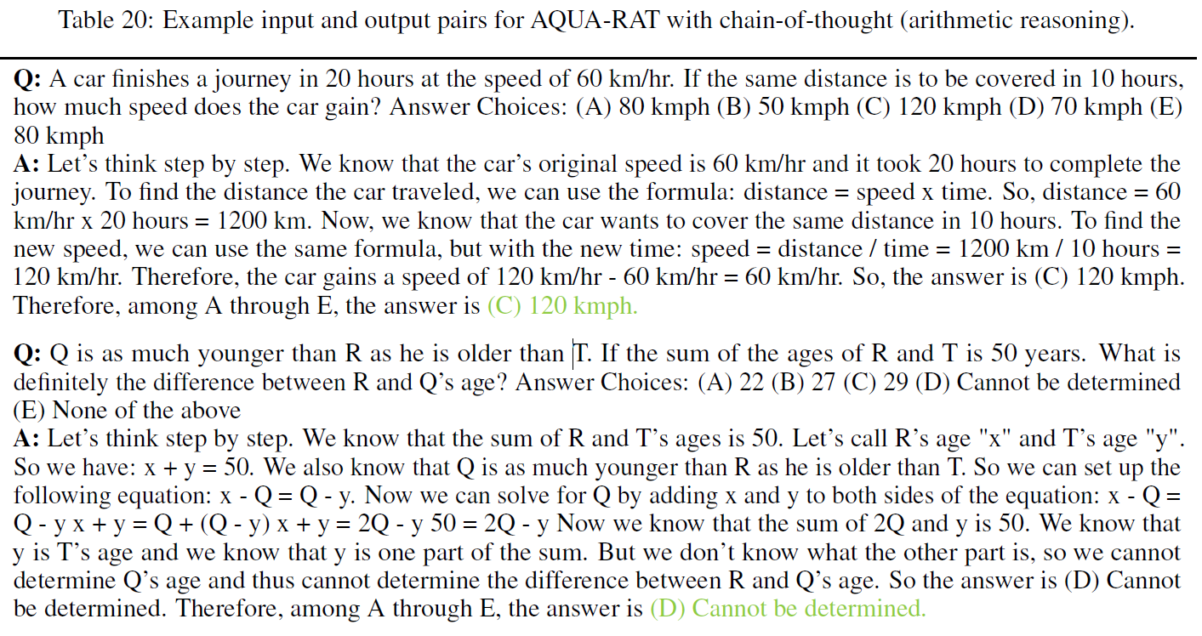
Methodology
Example for Arithmetic

Slide 13
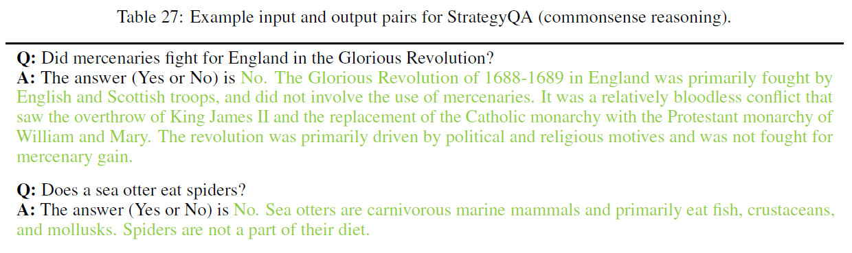
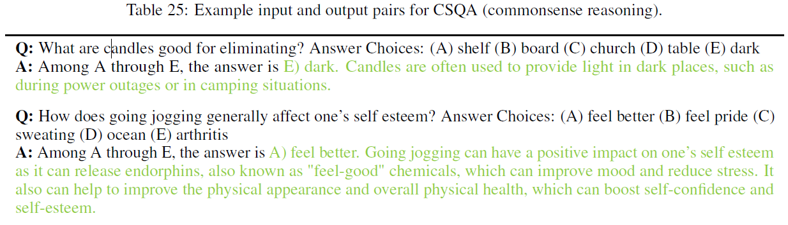
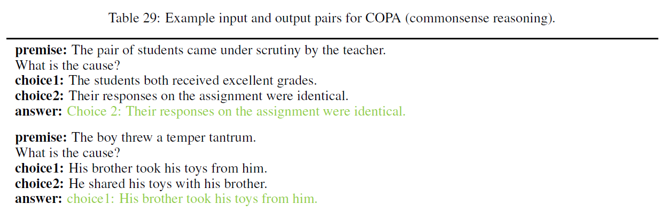
Methodology
Example for Commonsense

Slide 14
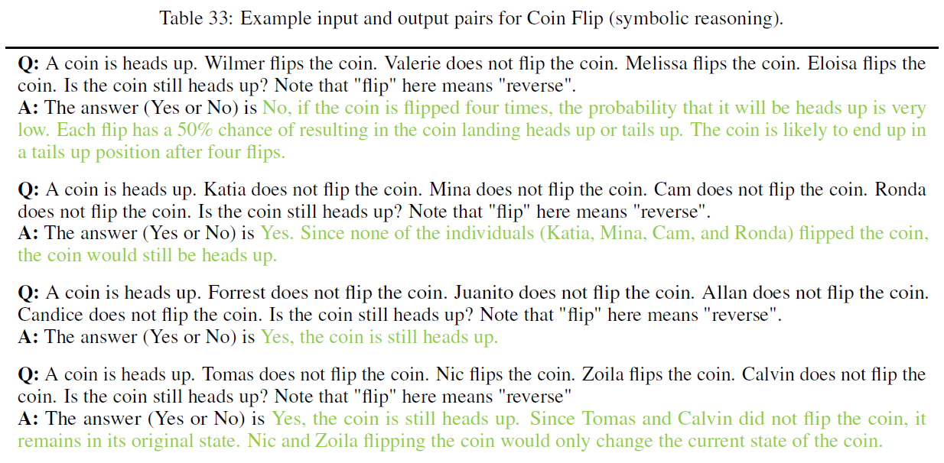
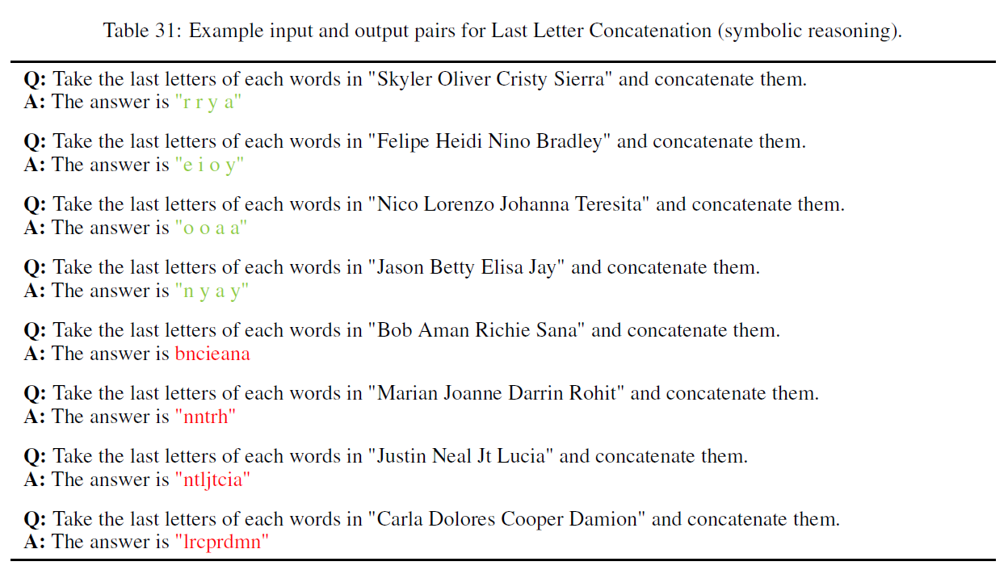
Methodology
Example for Symbolic

Slide 15
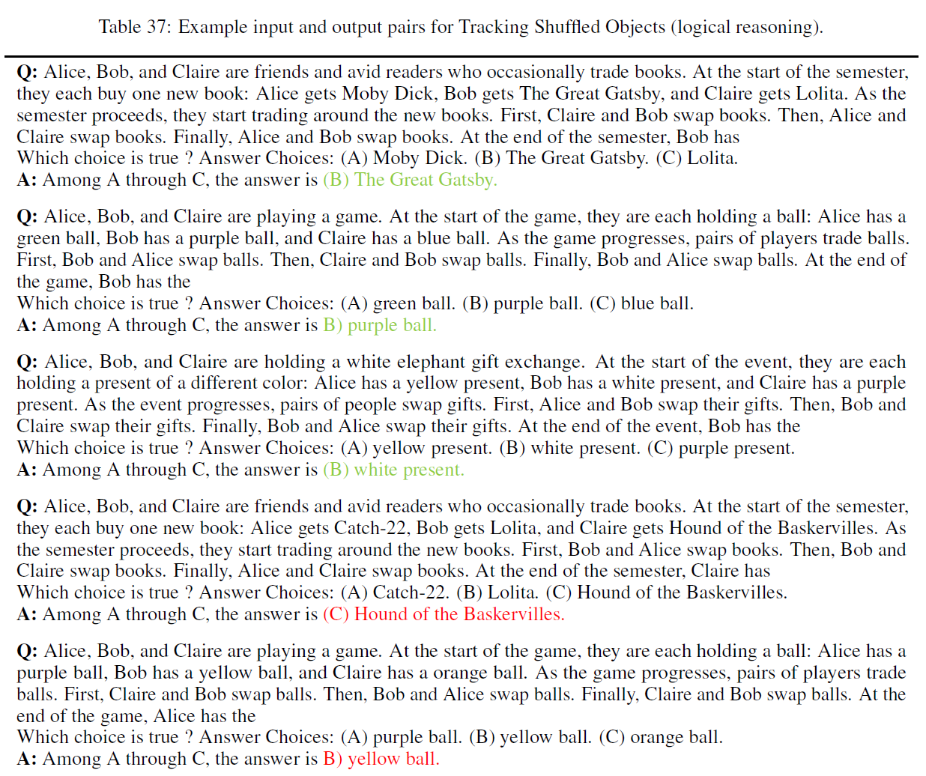
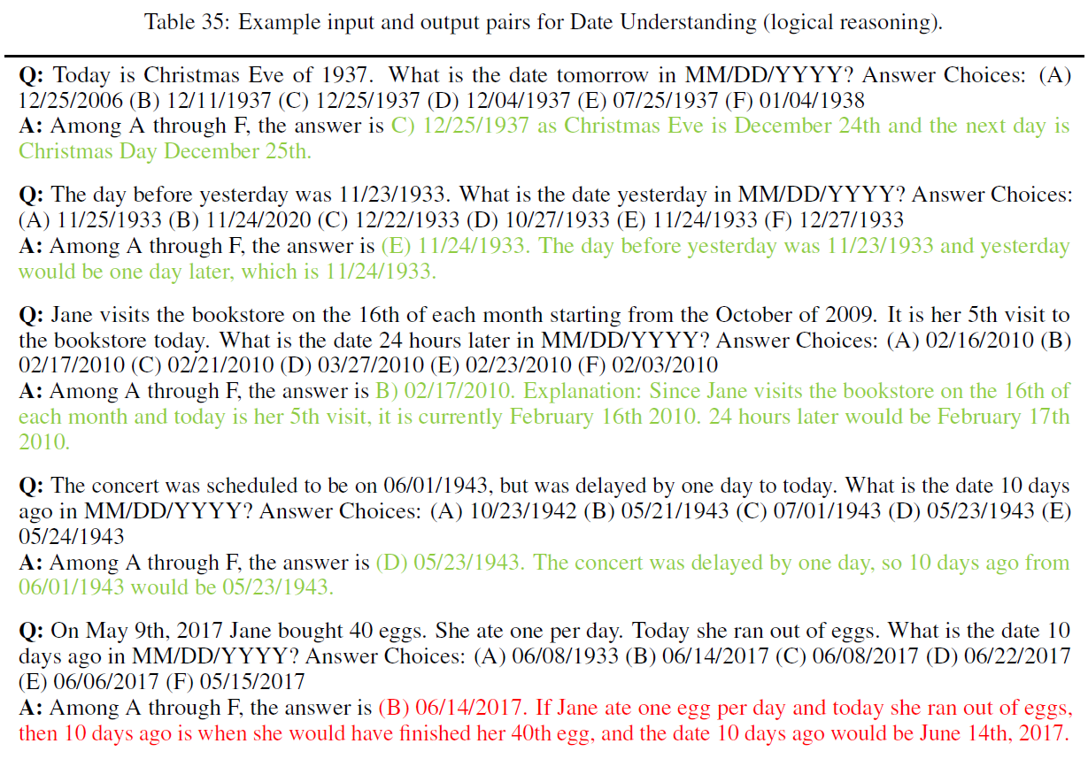
Methodology
Example for Logical

Slide 16
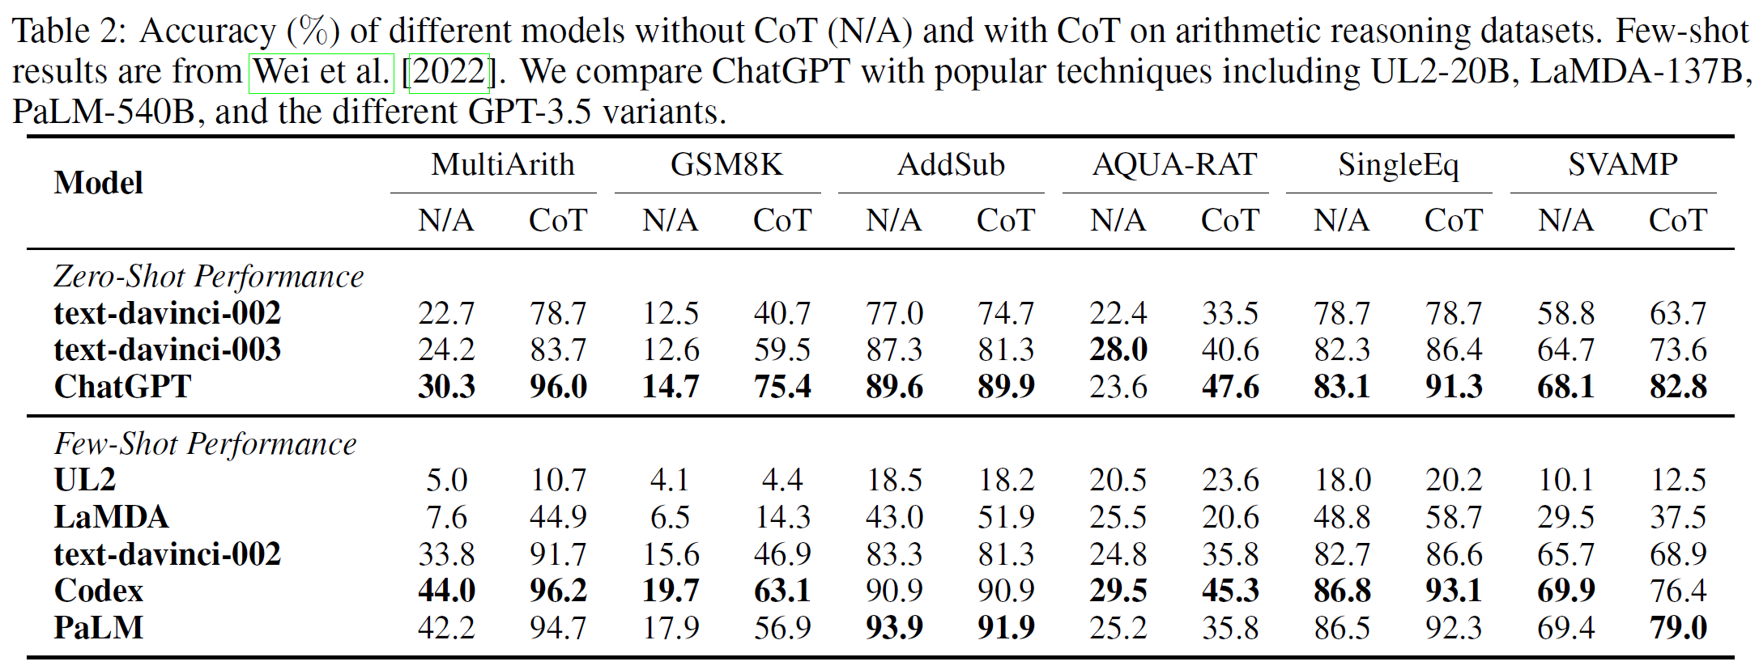
Experiments Results
Arithmetic Reasoning
Conclusion:
ChatGPT outperforms GPT-3.5 on five out of six datasets without CoT
ChatGPT achieves much better performance than GPT-3.5 when using CoT in all cases
CoT is much helpful

Slide 17
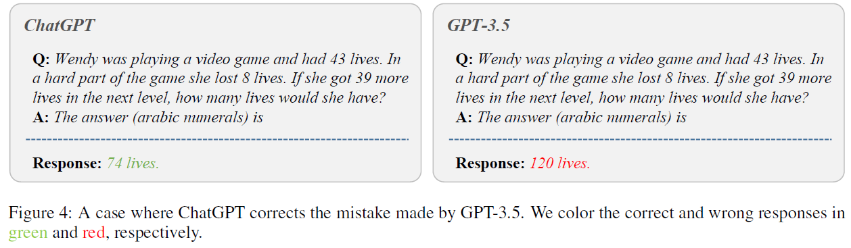
Experiments Results
Arithmetic Reasoning
Conclusion:
ChatGPT accurately understands “lost 8 lives” and “got 39 more lives”, resulting in the correct answer “74 lives”. However, GPT-3.5 generates a wrong answer “120 lives” that is irrelevant to the information provided, indicating that GPT-3.5 does not understand the input question.

Slide 18
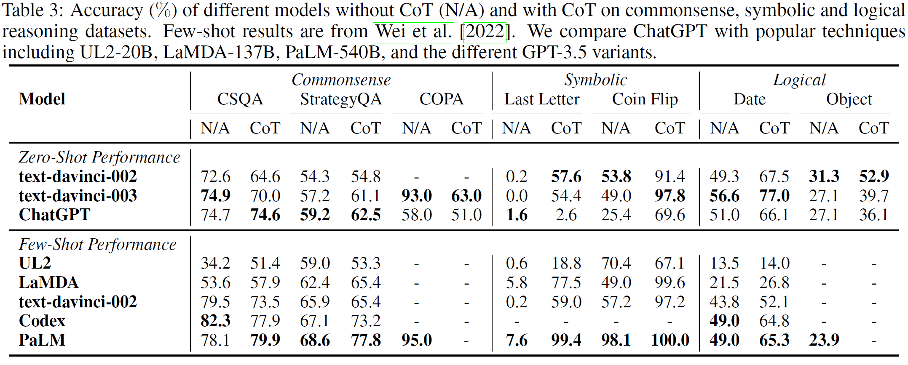
Experiments Results
Commonsense, Symbolic, and Logical Reasoning
Key Observations 1:
Using CoT may not always provide better performance in commonsense reasoning tasks.
CoT methods often produce flexible and reasonable rationales but the final prediction is not correct in commonsense reasoning tasks.
The results imply that commonsense reasoning tasks may require more fine-grained background knowledge.

Slide 19
Experiments Results
Commonsense, Symbolic, and Logical Reasoning
Key Observations 2:
Different from arithmetic reasoning, ChatGPT performs worse than GPT-3.5 in many cases.
ChatGPT performs much worse than GPT-3.5 on COPA that requires commonsense causal reasoning ability.
ChatGPT can easily generate uncertain responses, leading to poor performance.
Notes:
符号学，last letter 和coin flip两个数据集
以及logical 的两个数据集，作者似乎没有做特定的分析，不知道是什么原因

Slide 20
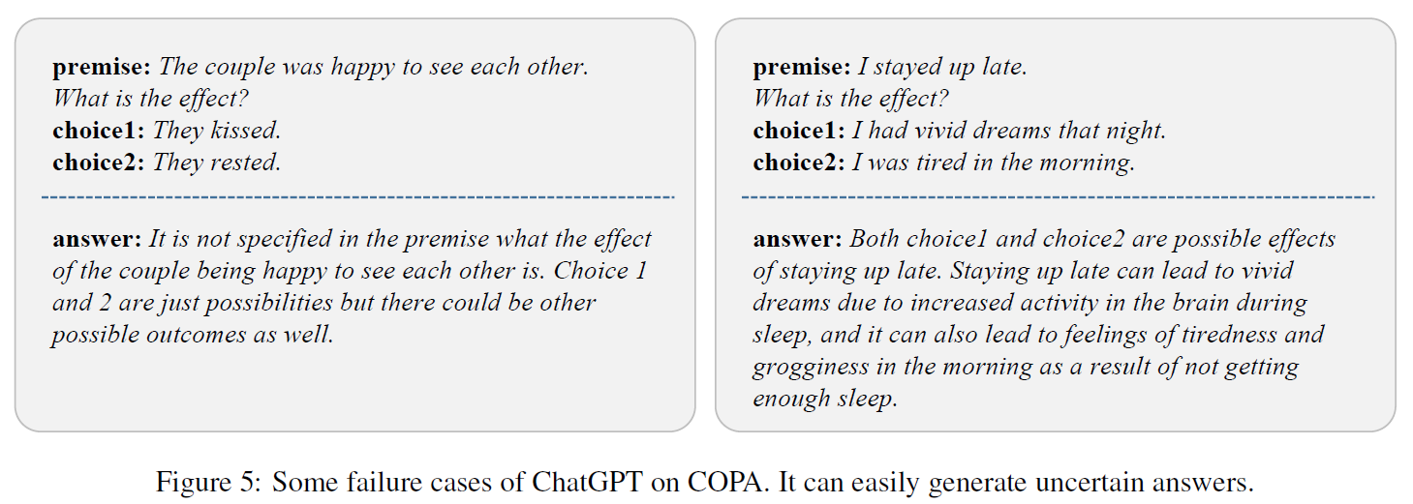
Experiments Results
Commonsense, Symbolic, and Logical Reasoning
Key Observations 2:
Different from arithmetic reasoning, ChatGPT performs worse than GPT-3.5 in many cases.
ChatGPT performs much worse than GPT-3.5 on COPA that requires commonsense causal reasoning ability.
ChatGPT can easily generate uncertain responses, leading to poor performance.

Slide 21
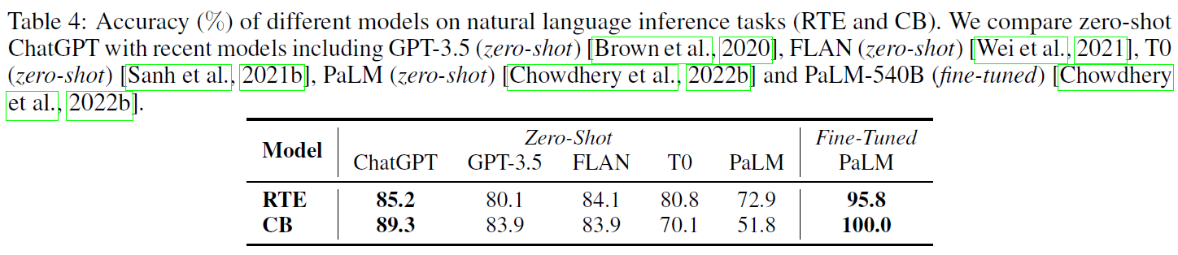
Experiments Results
Natural Language Inference
Conclusion:
ChatGPT can achieve much better performance than GPT-3.5, FLAN, T0, and PaLM under the zero-shot setting
This demonstrates the superior zero-shot capability of ChatGPT to infer sentence relations.

Slide 22
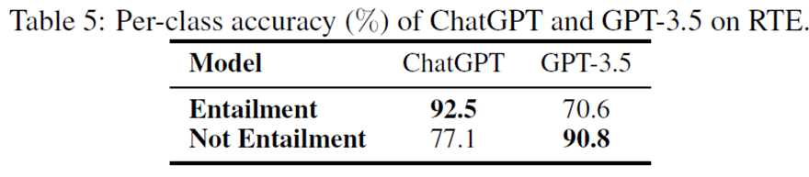
Experiments Results
Natural Language Inference
To take a closer look at why ChatGPT outperforms GPT-3.5 by a large margin, we report the per-class accuracy of both models
Observation:
ChatGPT performs much better than GPT-3.5 when the premise does entail the hypothesis (+22%).
However, it underperforms GPT-3.5 on the class “Not Entailment” (-14%).
Conclusion:
ChatGPT is better at handling factual input (also favored by humans in general), which might be related to the preference of the human feedback in its own RLHF design during model training.

Slide 23
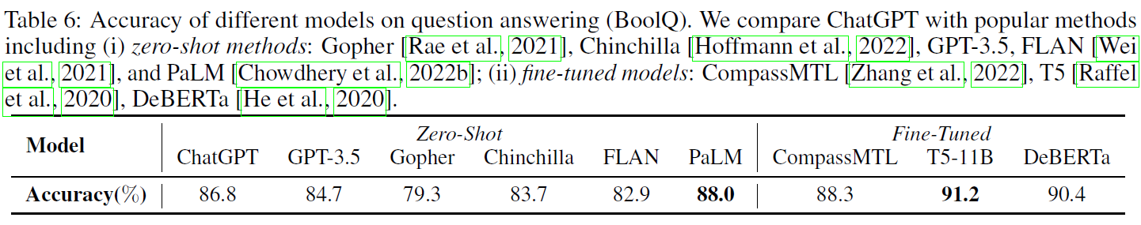
Experiments Results
Question Answering
Conclusion:
ChatGPT outperforms GPT-3.5 by over 2%, which is consistent with the results on natural language inference.
The questions in BoolQ require difficult entailment-like inference to solve, so ChatGPT can better handle tasks favoring reasoning capabilities.

Slide 24
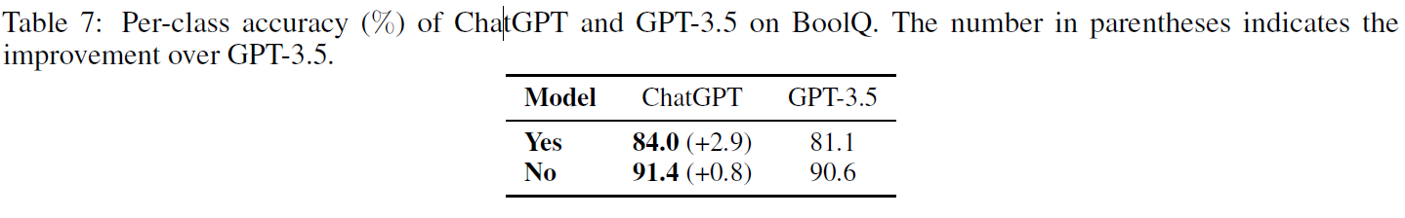
Experiments Results
Question Answering
Conclusion:
the improvement of ChatGPT over GPT-3.5 on the class “Yes” is more significant, indicating that ChatGPT prefers handling factual input.
In addition, although we require ChatGPT to output “Yes” or “No” via task instructions, it still generates some other responses, e.g., “It is unclear”, which could be one of the reasons why ChatGPT performs worse than PaLM.
Notes:
擅长处理事实输入
Chatgpt更保守

Slide 25
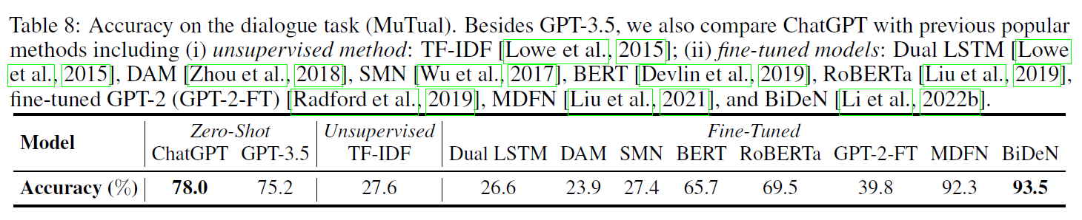
Experiments Results
Dialogue
Conclusion:
ChatGPT outperforms GPT-3.5 by a large margin—this is consistent with the impressive dialogue ability of
ChatGPT that has already been observed in the community

Slide 26
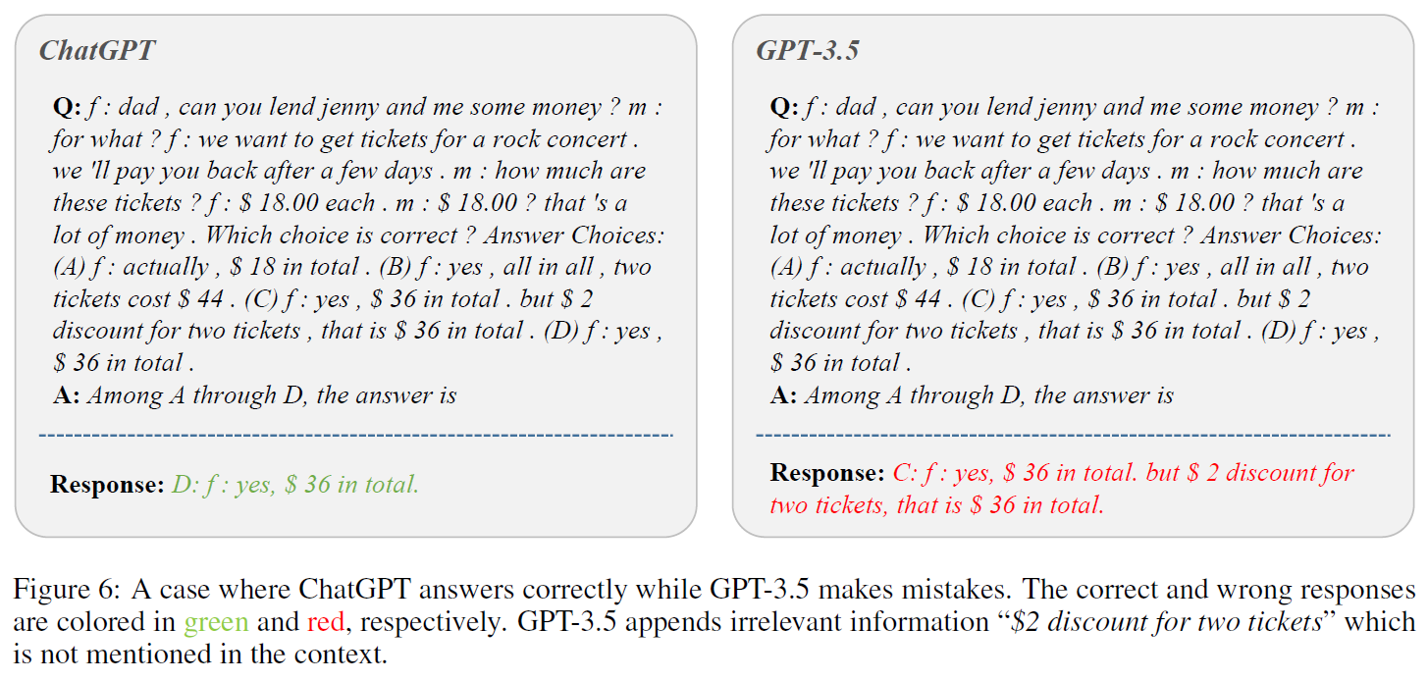
Experiments Results
Dialogue
Conclusion:
ChatGPT is able to reason more effectively about the given context without adding irrelevant information.
This reiterates the superior reasoning capability of ChatGPT.

Slide 27
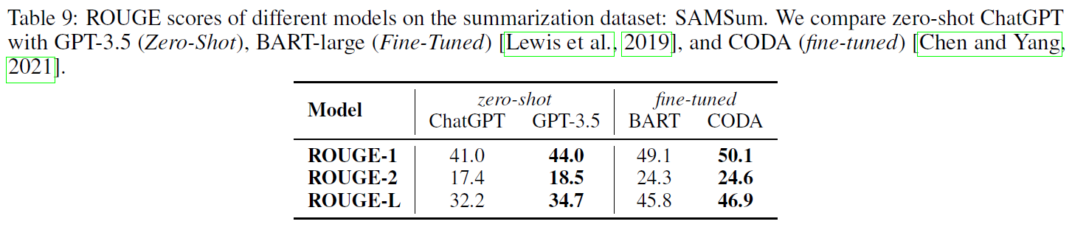
Experiments Results
Summarization
Conclusion: Surprisingly, ChatGPT underperforms GPT-3.5 across all measures.

Slide 28
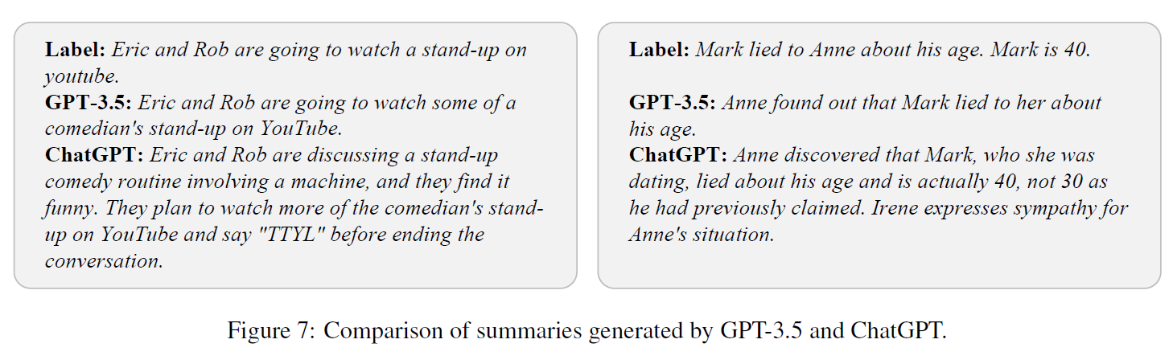
Experiments Results
Summarization
We hypothesize that this is due to the fact we do not explicitly control the output length of ChatGPT.
The responses from ChatGPT are usually more verbose than GPT-3.5, resulting in lower ROUGE scores.
ChatGPT’s responses are much longer: [ground truth (20.0), GPT-3.5’s (23.3), and ChatGPT’s (43.2)].
However, limiting the output length of ChatGPT is not helpful:
we explicitly limits the output length with a new instruction: “Please summarize the given conversation in no more than 25 words.”
Although the average number of words in ChatGPT’s answers is reduced to 25.8, the average score of ROUGE-1/2/L drops from 30.2 to 29.3
Notes:
So we conclude that controlling
the length of summaries via zero-shot instructions may harm ChatGPT’s summarization ability.

Slide 29
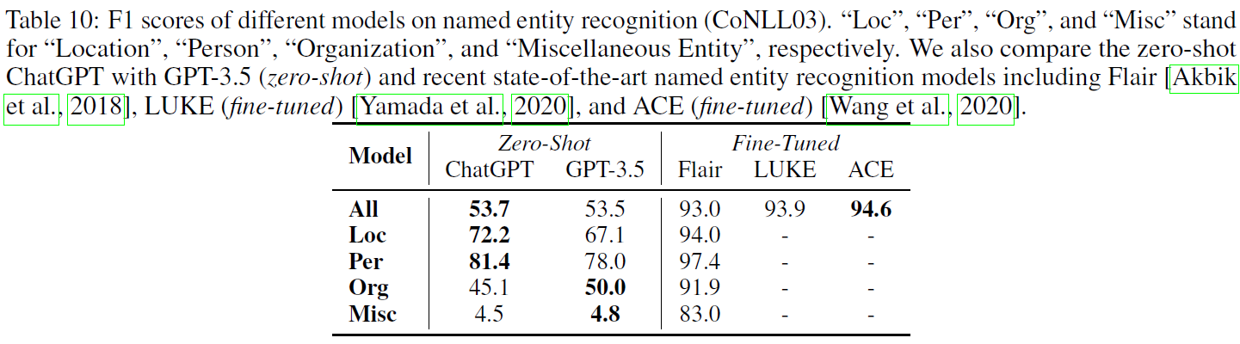
Experiments Results
Named Entity Recognition
Conclusion:
the overall performance of ChatGPT and GPT-3.5 is quite similar.
Unfortunately, they fail to achieve satisfactory results on each named entity type compared to previous fine-tuning methods.
This shows that current LLMs still face challenges in solving specific tasks, such as sequence tagging.
Notes:
此外，作者也尝试了不同的instruction，但是最后的结果仍然很低 F1 34.8，所以还是说明这个任务没办法胜任
有一个问题是misc混杂实体正确率特别低，所以作者做了case study

Slide 30
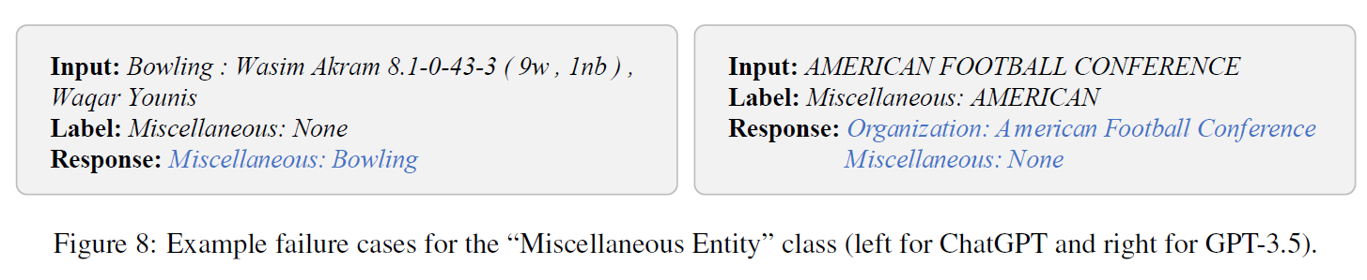
Experiments Results
Named Entity Recognition
Observation 1:
On the left part of the figure, LLMs recognize “Bowling” as a miscellaneous entity while the ground truth is ‘None’. However, “Bowling” does belong to the entity type “ball”, which can be regarded as a miscellaneous type
Observation 2:
On the right part, although “AMERICAN FOOTBALL CONFERENCE” is indeed an organization, it is not recognized by the ground truth annotation, indicating that the ground truth annotation might need cleaning (although in rare cases).
Conclusion:
the poor performance on the class “Miscellaneous Entity” may be partly due to the different understanding on the scope of entities between LLMs and the ground truth annotation of the specific task dataset
Notes:
结论就是grount truth的标注不一定是完全正确的，所以这一项显得特别的低

Slide 31
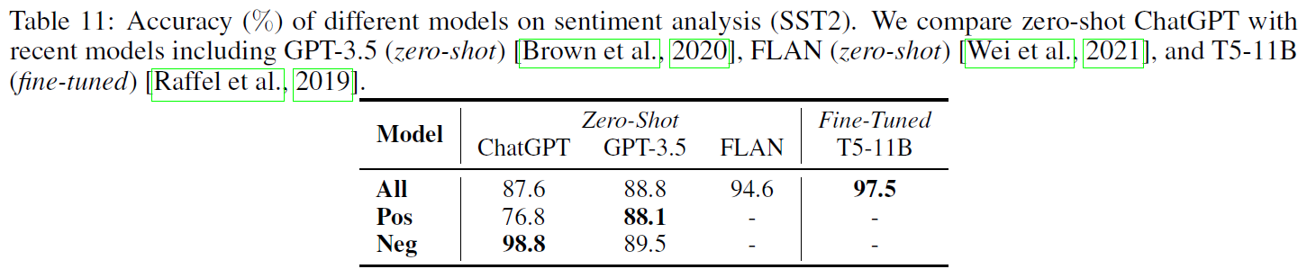
Experiments Results
Sentiment Analysis
Observation:
ChatGPT performs worse than GPT-3.5 by roughly a 1% accuracy drop.
The performance of ChatGPT on different classes is rather unbalanced: It performs nearly perfectly on negative samples while the performance on positively-labeled data is much worse, which leads to poor overall performance.
Notes:
In addition, although we explicitly specified that the answer should be exact “positive” or “negative” in task instructions (Figure 2), ChatGPT and GPT-3.5 still output some other answers, e.g., “neutral” and “mixed”, which partly explains why they perform much worse than FLAN

Slide 32
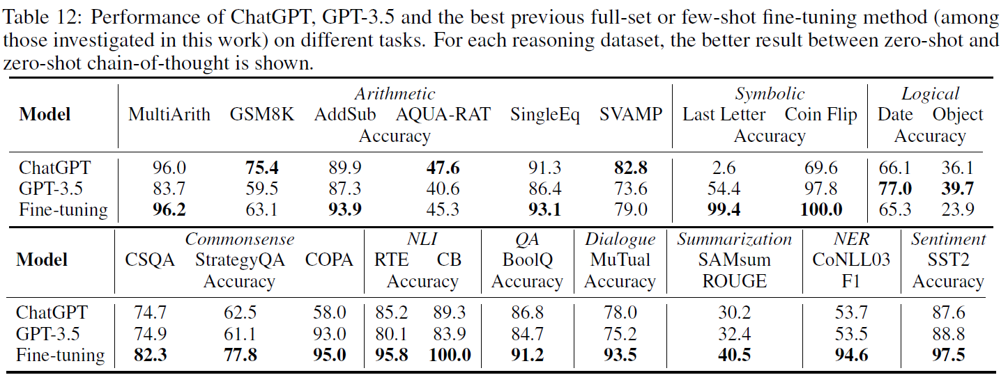
Experiments Results
ChatGPT v.s. Full-Set or Few-Shot Fine-Tuning
Conclusion:
ChatGPT underperforms previous fine-tuning methods in most cases, indicating that ChatGPT is still far from a perfect generalist.

Slide 33
Key findings and insights
Although ChatGPT shows capability as a generalist model on multiple tasks, it performs worse than models that are fine-tuned on a given task
ChatGPT show superior reasoning capability in arithmetic reasoning tasks. However, ChatGPT underperforms GPT-3.5 in commonsense, symbolic, and logical reasoning tasks,
ChatGPT outperforms GPT-3.5 for NLI and QA tasks that reasoning logical relationships within text pairs. Specifically, ChatGPT is better at handling factually consistent text (i.e., better at classifying entailment rather than non-entailment).

Slide 34
Key findings and insights
ChatGPT is superior to GPT-3.5 for dialogue tasks
ChatGPT generates longer summaries and performs worse than GPT-3.5 for summarization tasks. However, explicitly limiting summary length harms the summarization quality
both ChatGPT and GPT-3.5 face challenges on certain tasks such as sequence tagging
ChatGPT’s sentiment analysis ability comes close to that of GPT-3.5

Slide 35
Conclusion
We have empirically studied the zero-shot learning capabilities of ChatGPT on a large, diverse collection of datasets covering representative task categories
Extensive experimental results and analysis demonstrated the effectiveness and current limitations of ChatGPT in different types of NLP tasks
For example, as a powerful generalist model, on one hand, ChatGPT is good at reasoning and dialogue tasks; on the other hand, ChatGPT still faces challenges when solving specific tasks, such as sequence tagging

